Slide 1
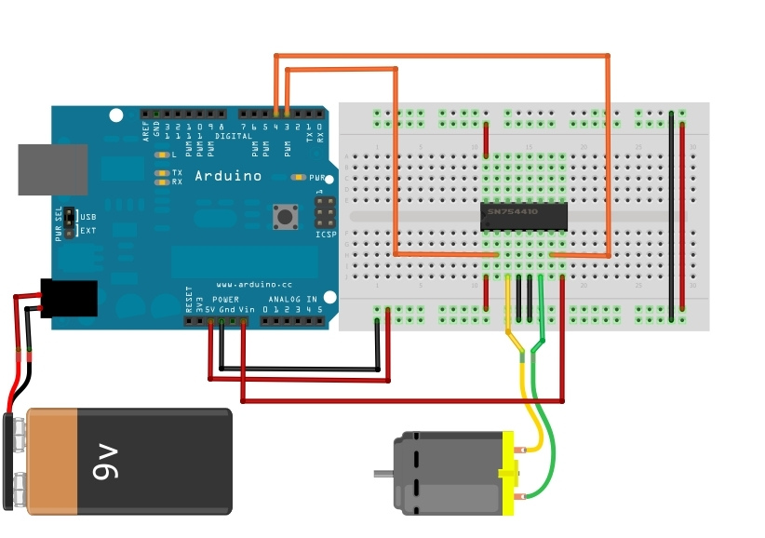
Connect
L293D pin | Arduino pin
2 | 4
7 | 3

Slide 2
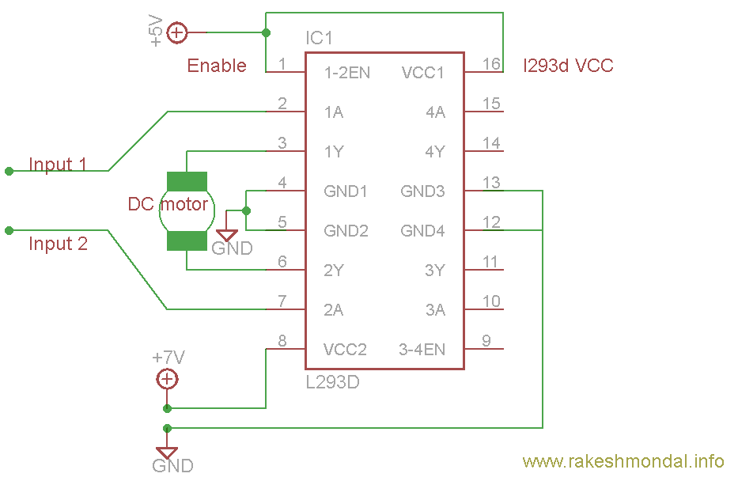
Motor Code
int motorpin1 = 3;
int motorpin2 = 4;
void setup () {
pinMode(motorpin1,OUTPUT);
pinMode(motorpin2,OUTPUT);
}
void loop () {
digitalWrite(motorpin1,LOW);
digitalWrite(motorpin2,HIGH);
}
Notes:
Make the motor increase speed by taking input of ldr data .

